Slide 1

Arrays

Slide 2
Recap
elif statement
variable += “string” / += 1
for loop
How to google a problem
Created a simple calculator
Created a for loop that calculates a triangular number

Slide 3
Example
What is in the variable?

Slide 4
Example
This is a Array of numbers.
variable has multiple values.

Slide 5
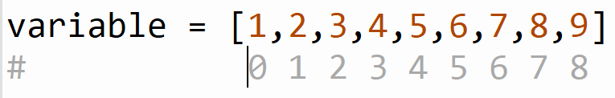
Example
1 is the first item of the array with the index of 0
2 is the second item of the array with the index of 1

Slide 6
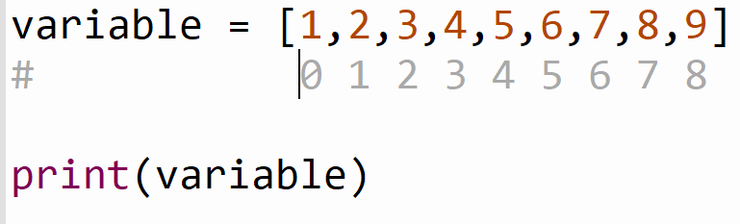
Example
What will happen if we print this?

Slide 7
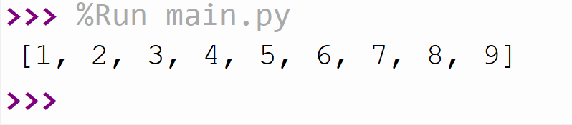
Example
It will print the whole array

Slide 8
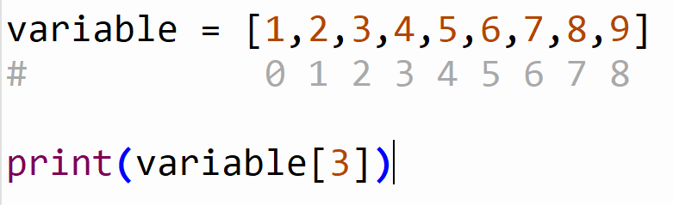
Example
What will happen if we print this?

Slide 9
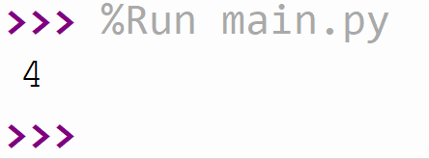
Example

Slide 10
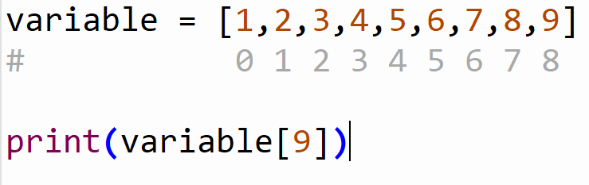
Example
What will happen if we print this?

Slide 11
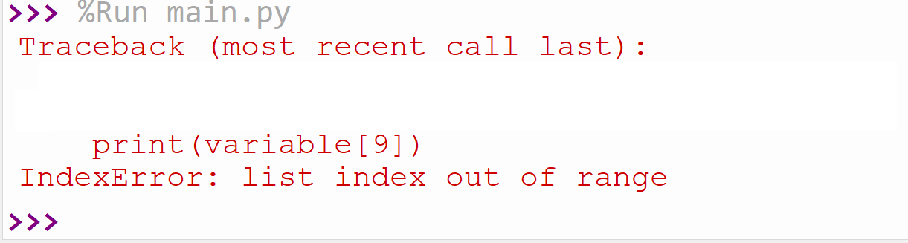
Example

Slide 12
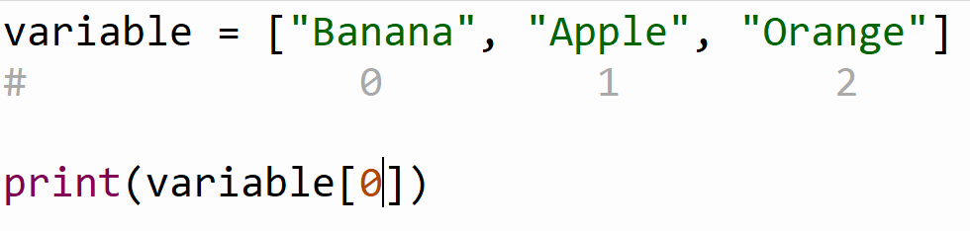
Example
What will happen if we print this?

Slide 13
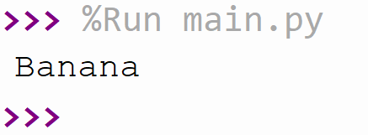
Example

Slide 14
Assignment (15 min)
Google how to loop through the array in Python
print the items in the loop one by one

Slide 15
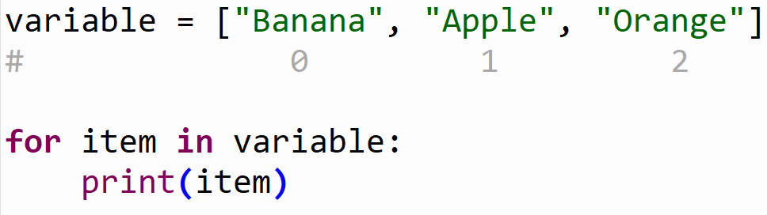
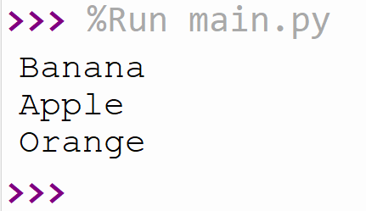
Assignment (15 min)

Slide 16
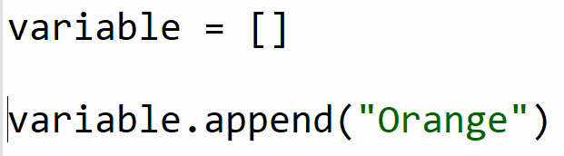
Example
What do you think the append function will do?

Slide 17
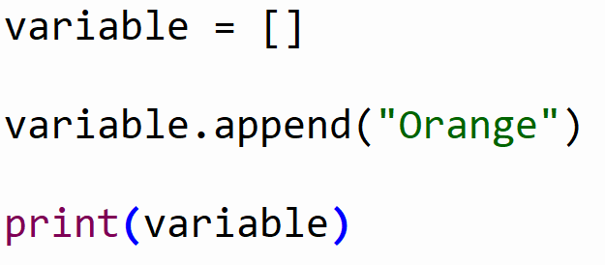
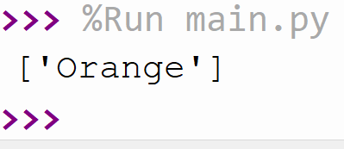
Example

Slide 18
Assignment Fibonacci (25 min)
Ask the user how long the array should be (input)
Check the input of the user
If it is 0 the result should be []
If it is 1 the result should be [1]
If it is 2 the result should be [1, 1]
Else it should be a list of the length of the input
The Fibonnaci seqence is a sequence of numbers where the next number in the sequence
is the sum of the previous two numbers in the sequence.
The sequence looks like this: 1, 1, 2, 3, 5, 8, 13, …)

Slide 19
Summary

